Slide 1
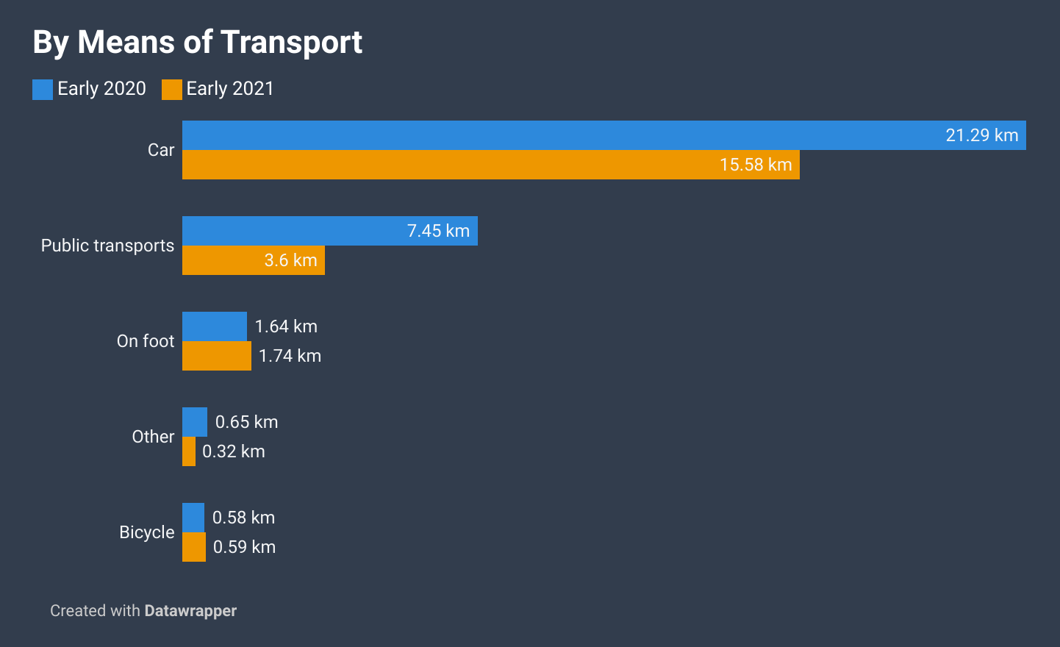
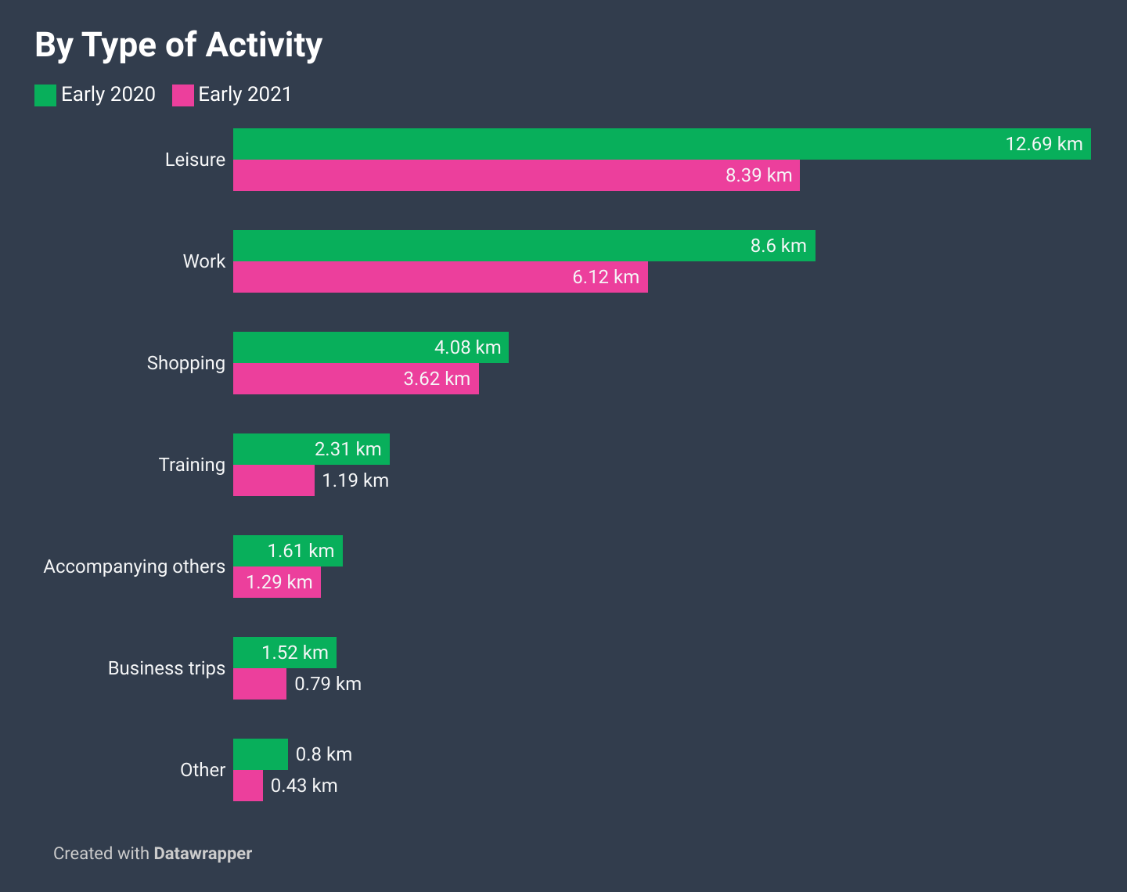
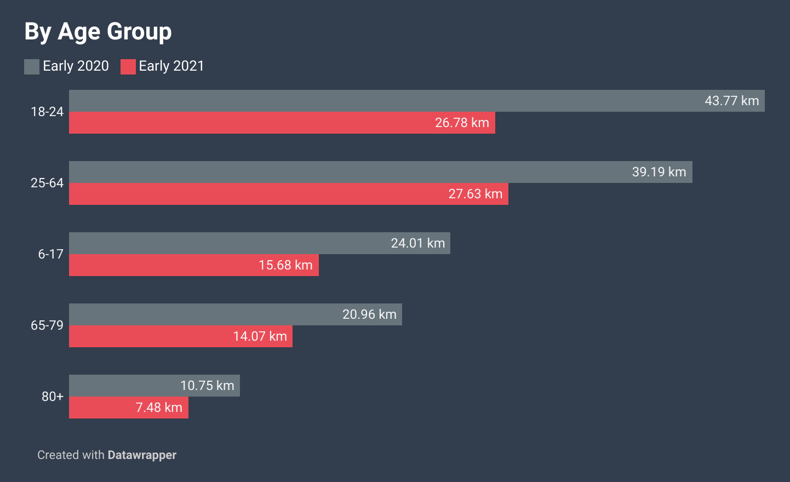

Slide 2
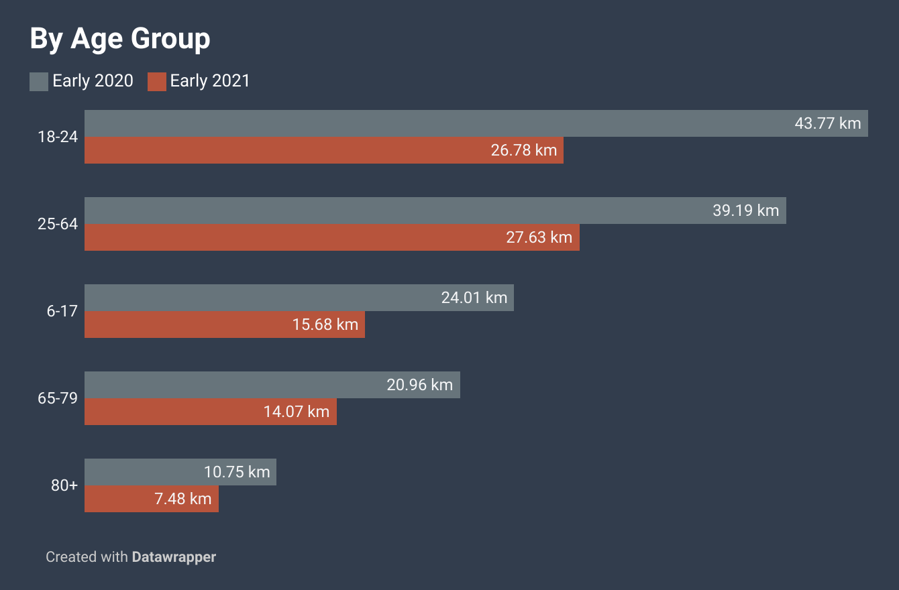
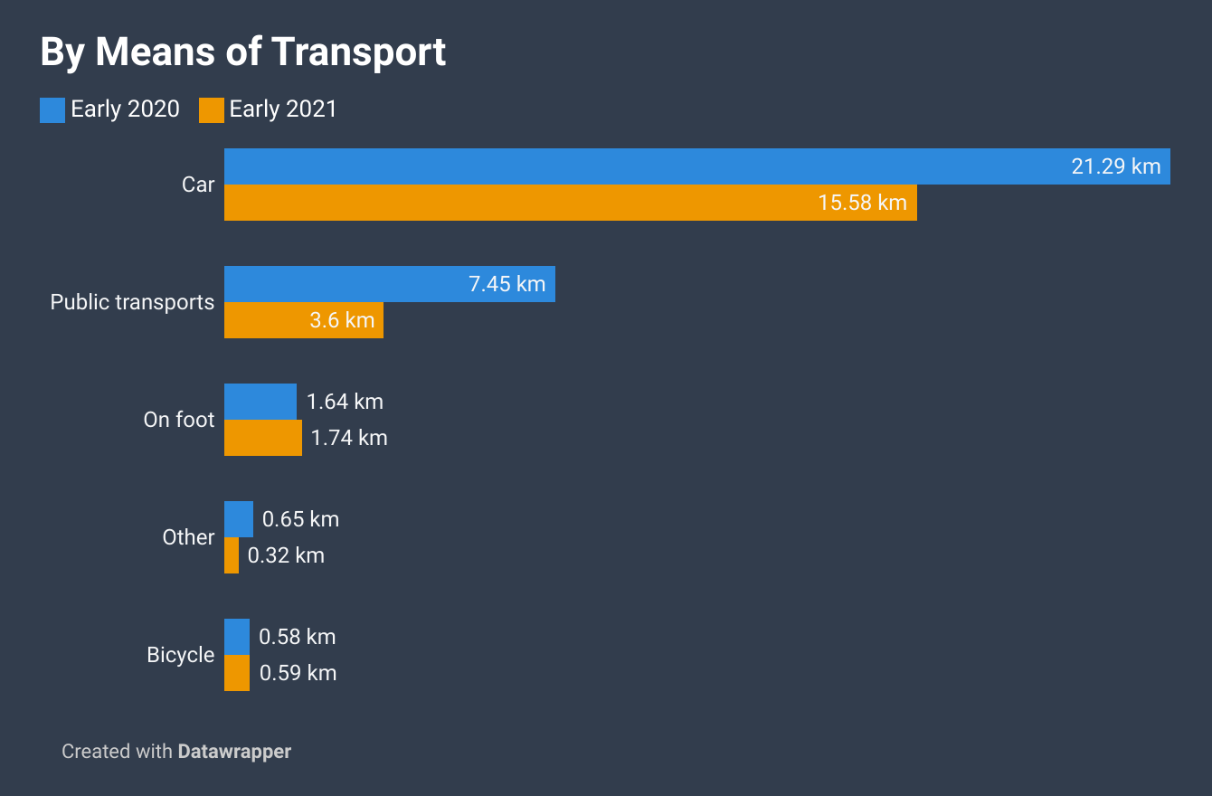
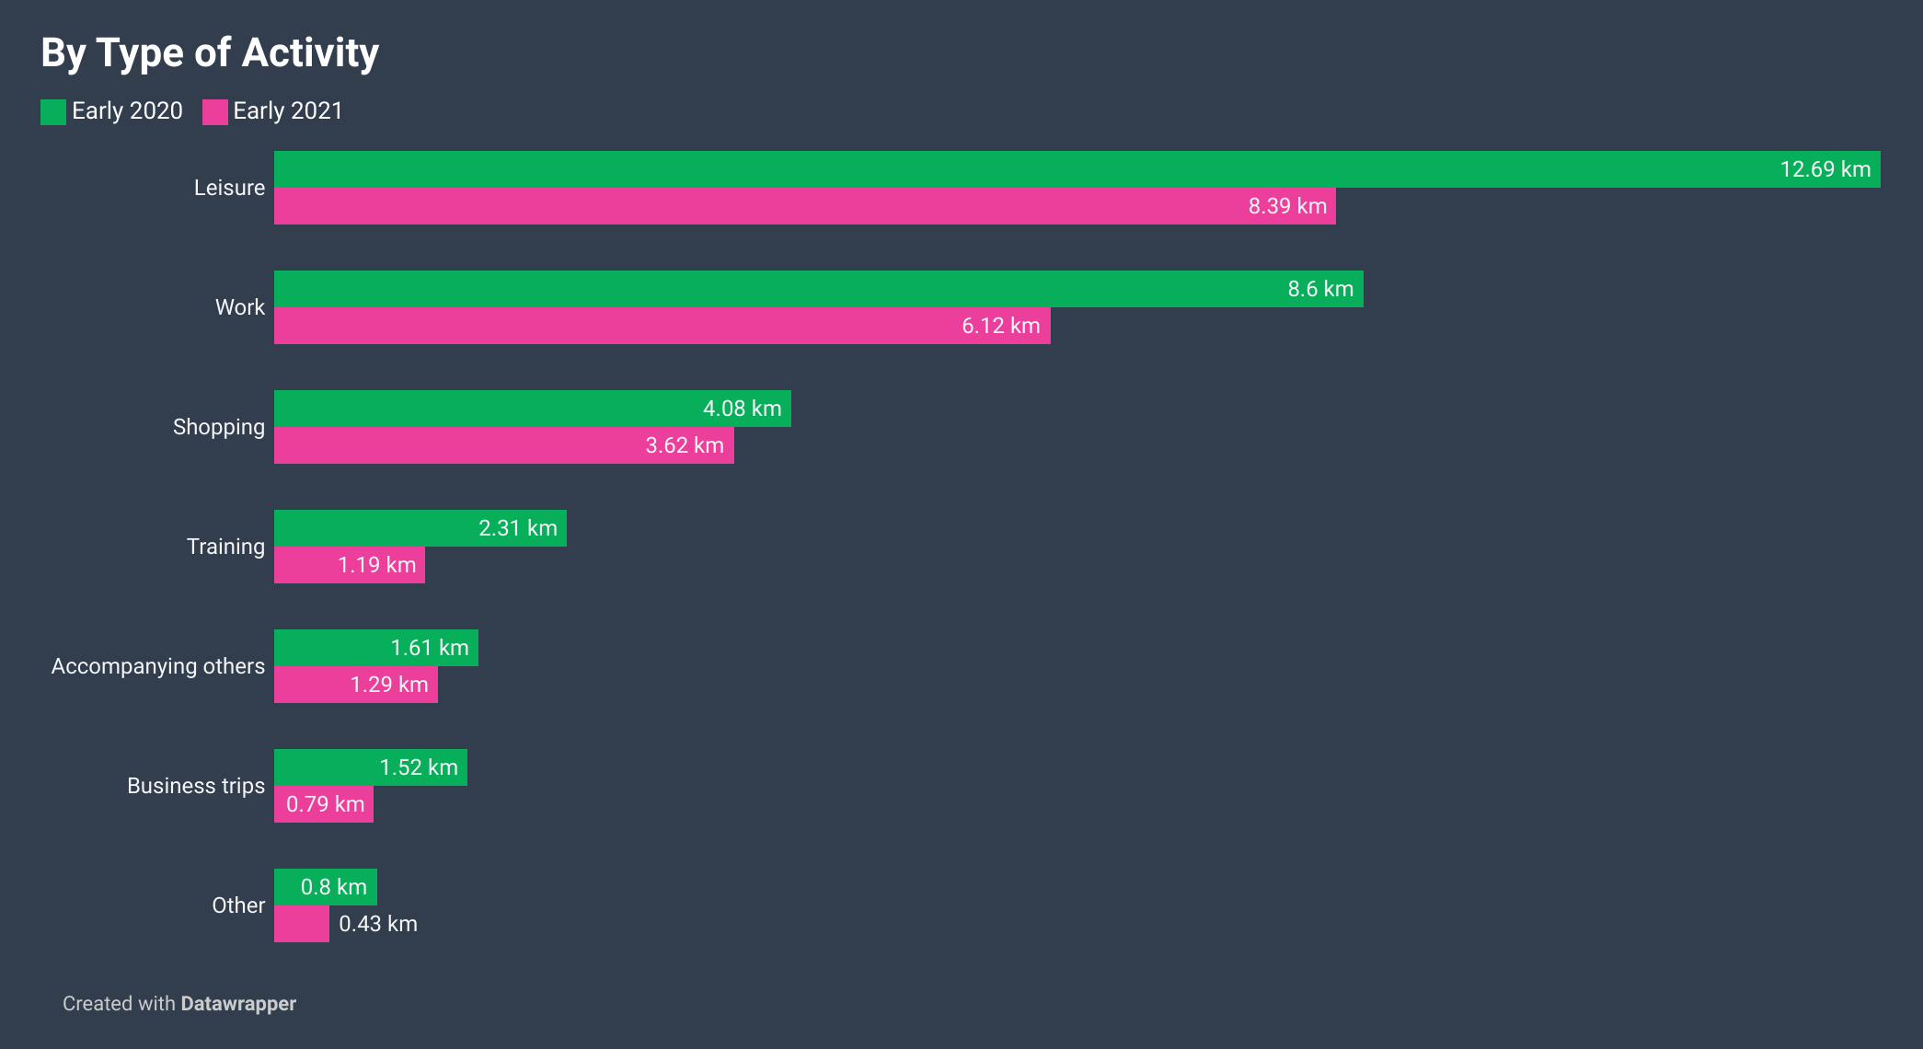

Slide 4
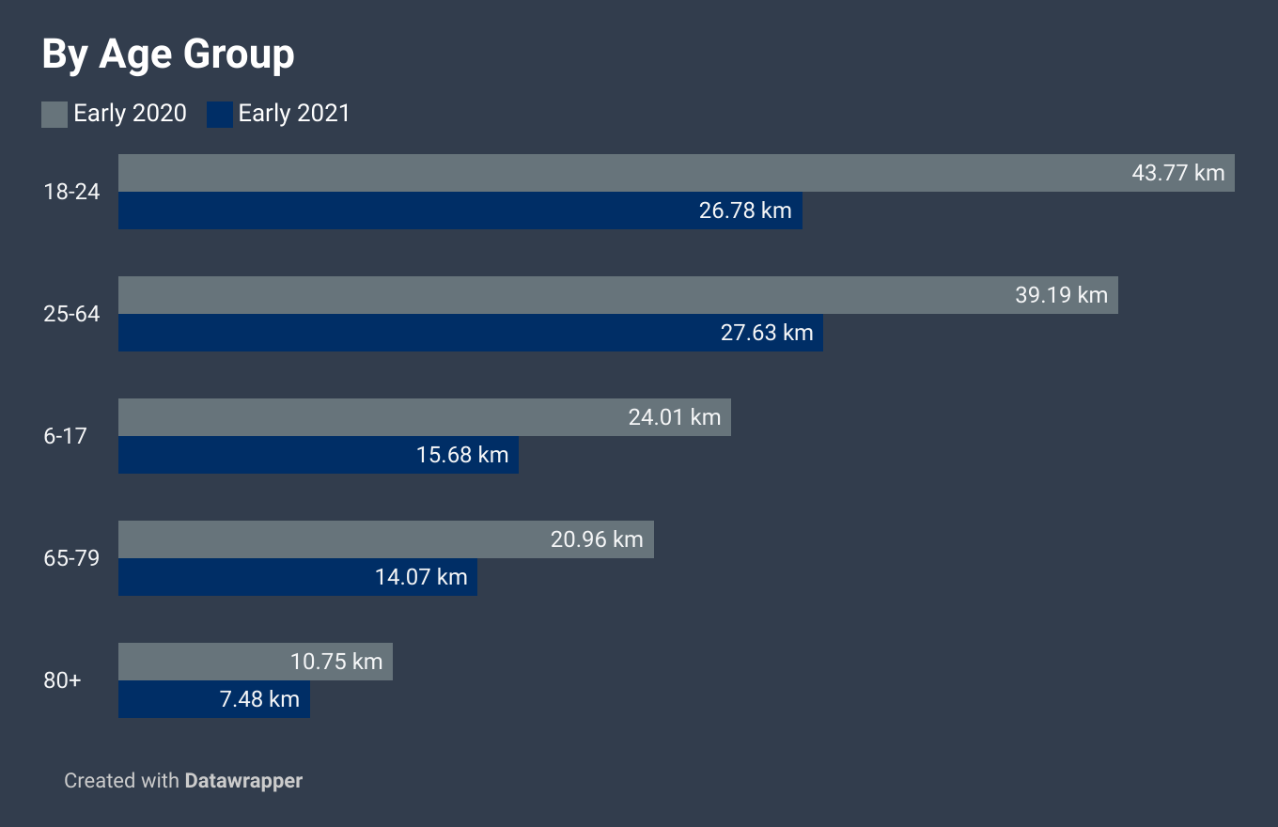
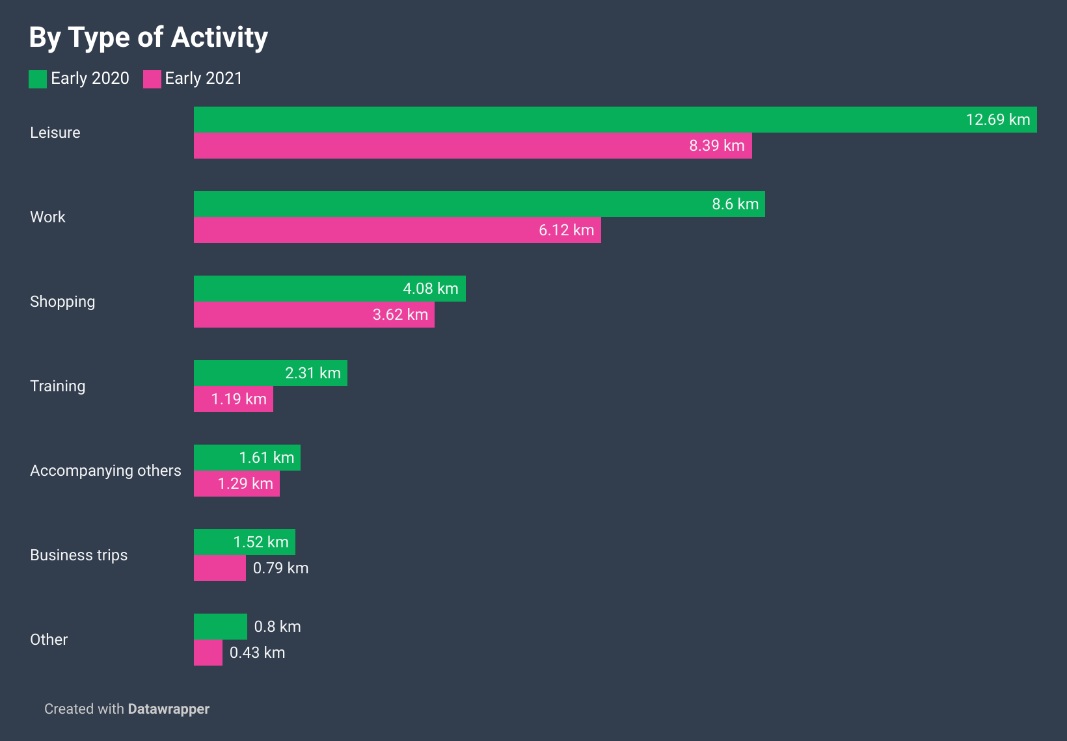
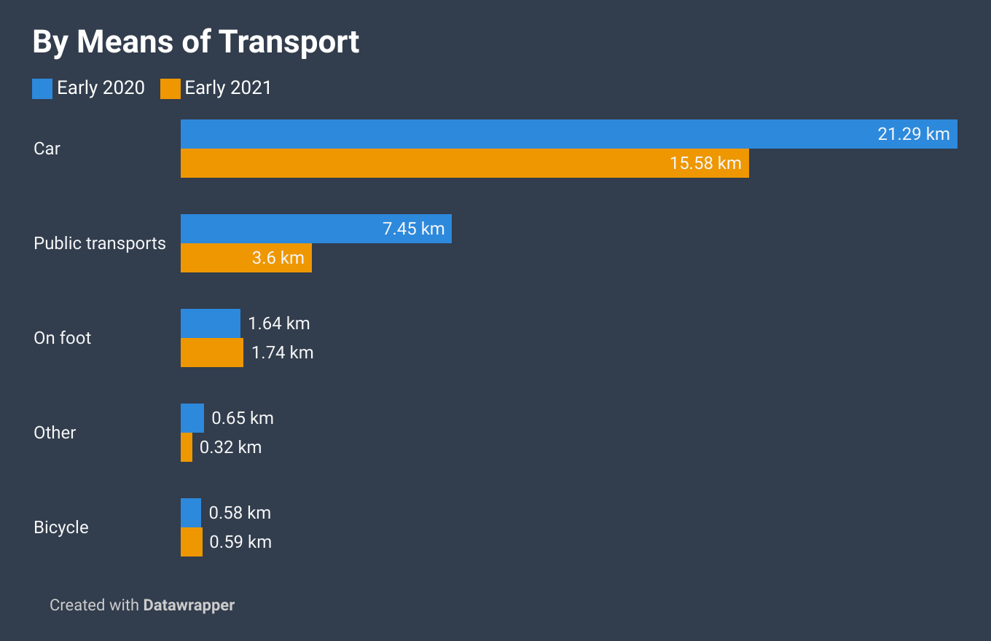

Slide 5
Mobility in Switzerland Before and During the Covid-19 Pandemic
Number of kilometers travelled daily by Swiss residents at the beginning of the pandemic (early 2021) and one year into the pandemic (early 2021)
Data from FSO's Experimental statistics. Charts inspired by same source.

Slide 6
Mobility in Switzerland Before and During Covid-19
Mean number of kilometers travelled daily by Swiss residents at the beginning of the pandemic (early 2020) and one year into the pandemic (early 2021). Data from FSO's Experimental statistics. Charts inspired by same source.

